Slide 1
Foreign Direct Investment Analysis
By Unmilan Baruah

Slide 2
Introduction
Investment is a game of understanding historic data of investment objects under different events but it is still a game of chances to minimize the risk we apply analytics to find the equilibrium investment. To understand the Foreign direct investment in India for the last 17 years from 2000-01 to 2016-17. This dataset contains sector and financial year-wise data of FDI in India. This report explains the key metrics and factors and shows the meaningful relationships between attributes.
Purpose
To analyze year-wise investment in India.
To analyze sector-wise investment in India.

Slide 3
Methodology
ETL (Extract, Transform, and Load): Collecting the data, transforming it into something which can be analyzed with accuracy, and loading the processed data for further analysis.
Data Analysis
Observations
Inference

Slide 4
ETL (Extract, Transform, and Load)
The data source is named as “FDI data.csv” and this CSV file records related to production of crops.
There are total 63 entries, but no null values. Therefore, data cleaning is not required.
Also, for the accuracy of the analysis and to avoid bias, we won’t remove the outliers. Also, we aren’t making any machine learning model for performing predictive analysis. So, removing the outliers is not an appropriate option.

Slide 5
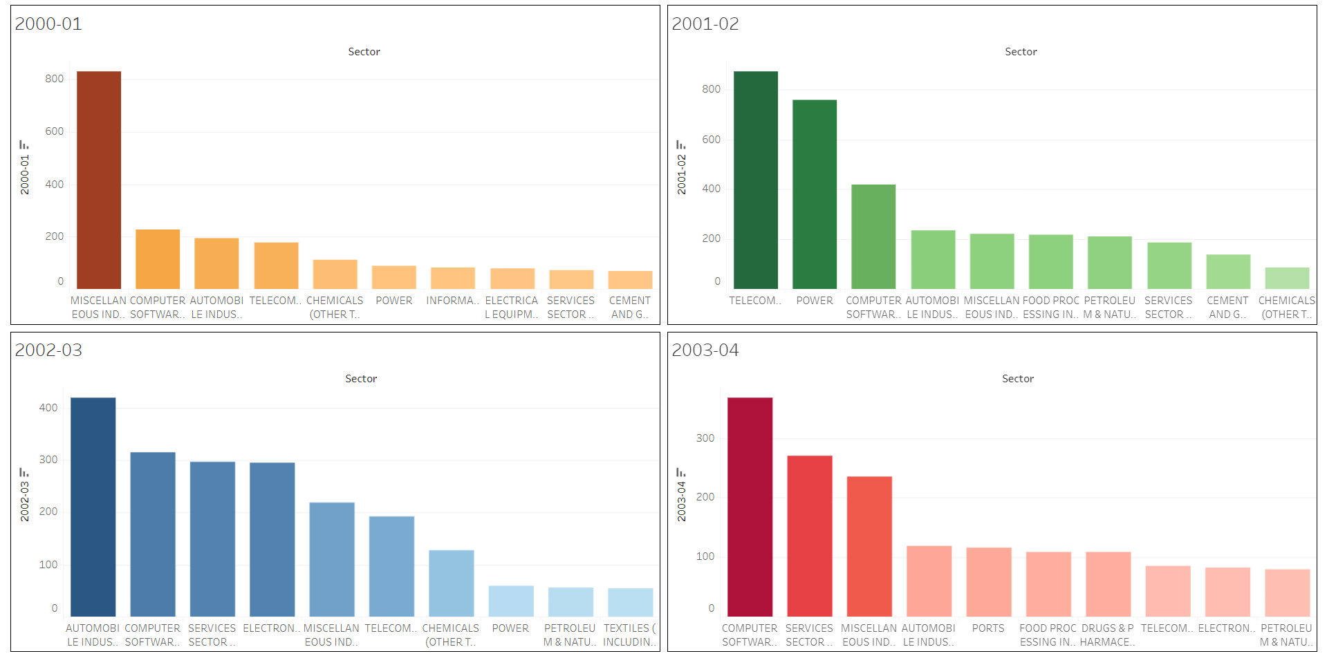
Data Analysis

Slide 6
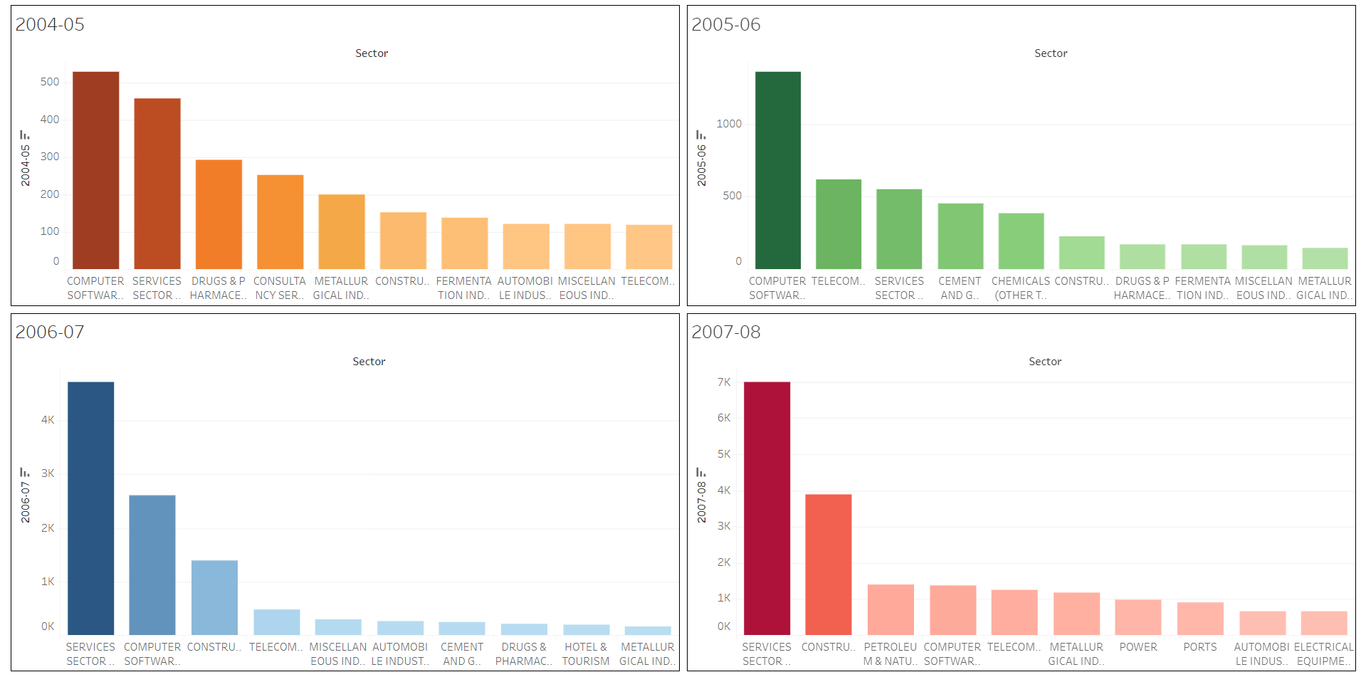
Data Analysis

Slide 7
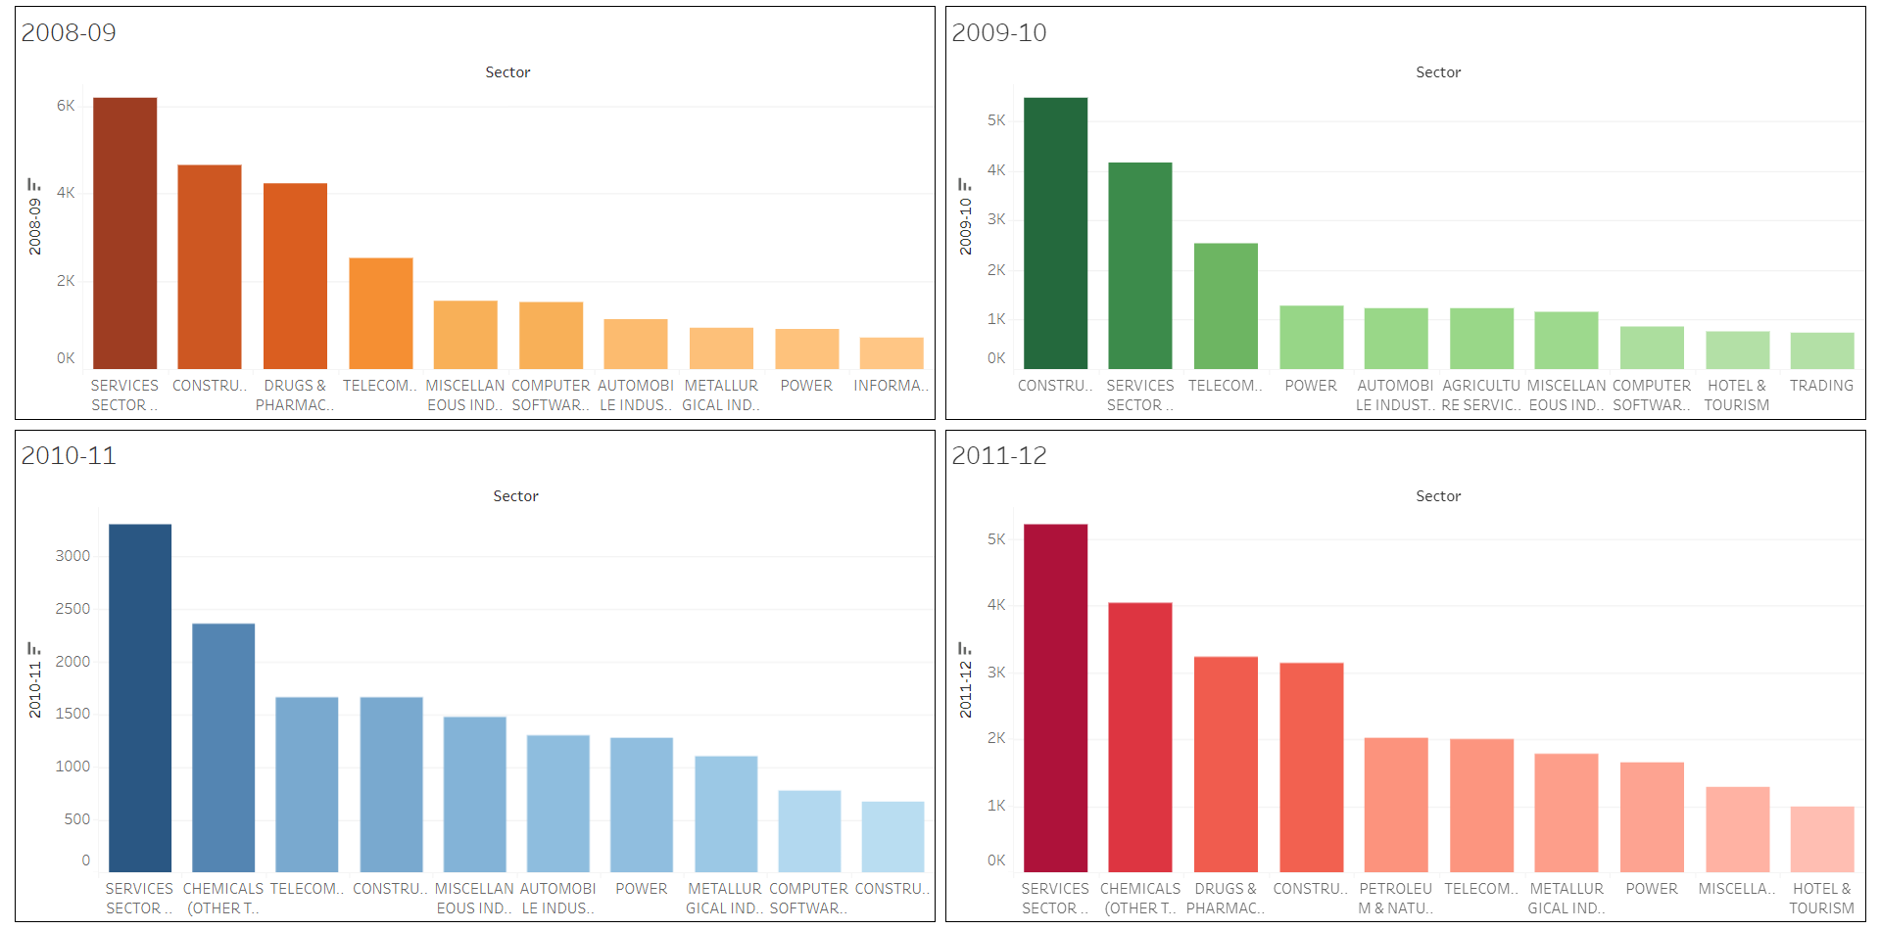
Data Analysis

Slide 8
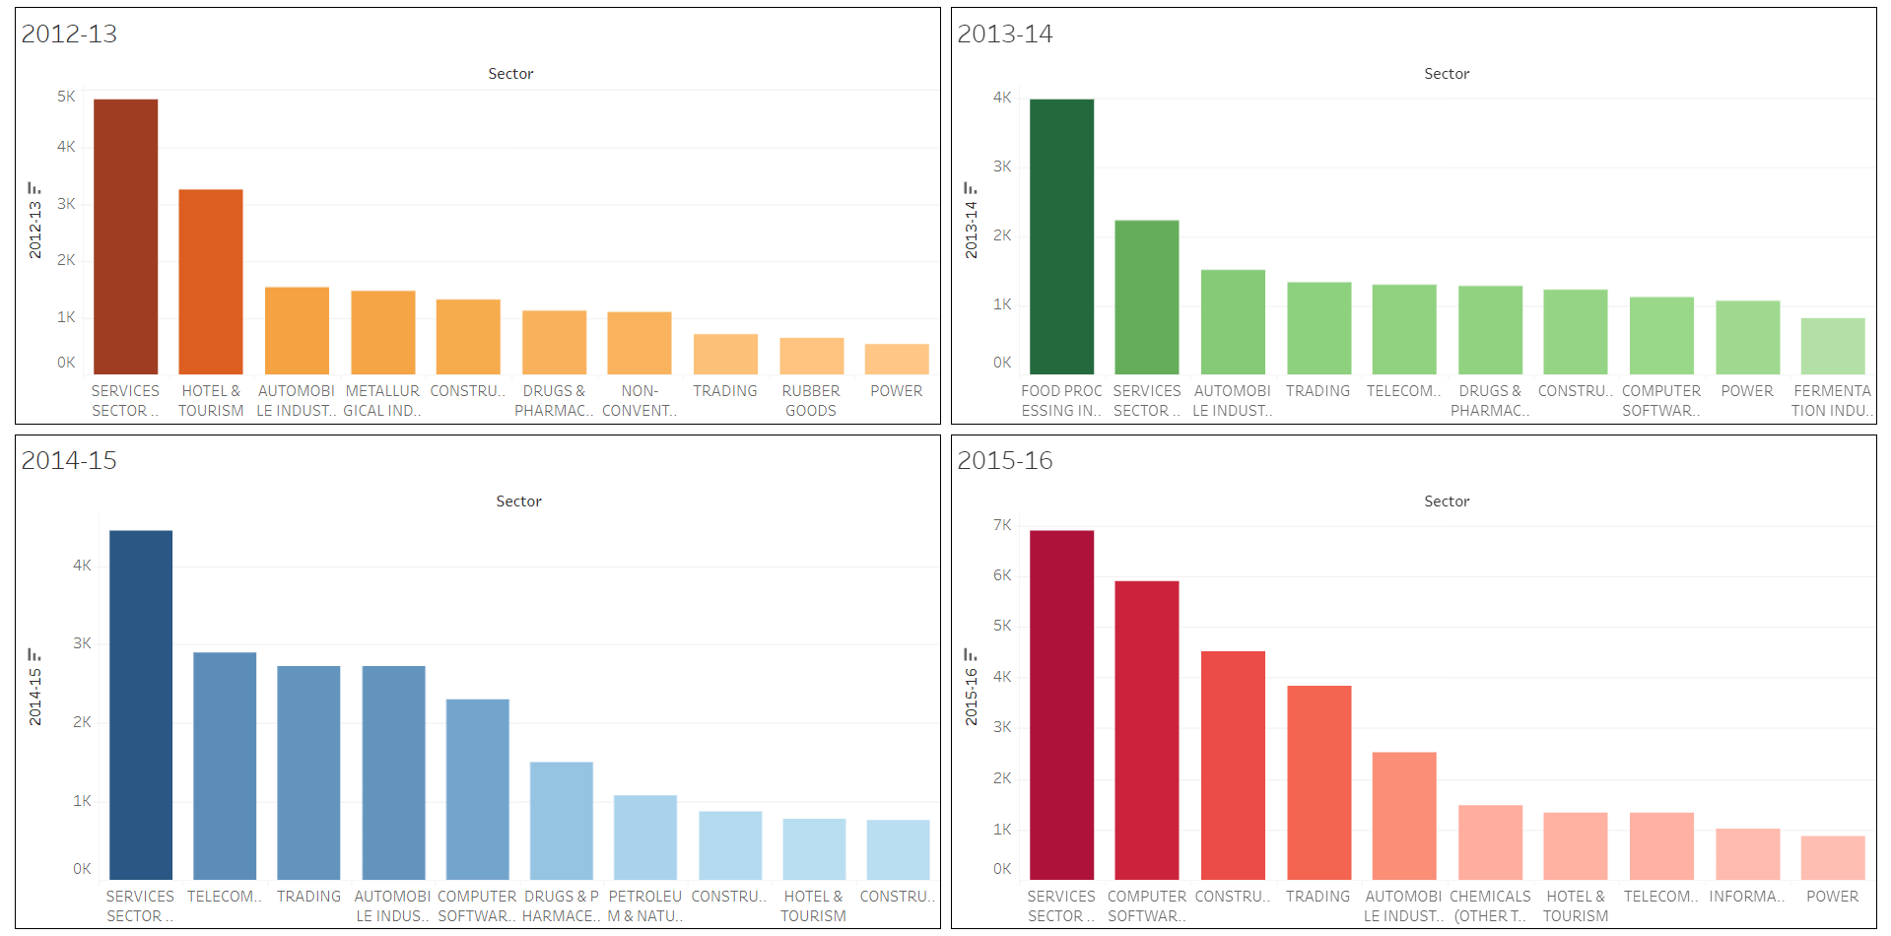
Data Analysis

Slide 9
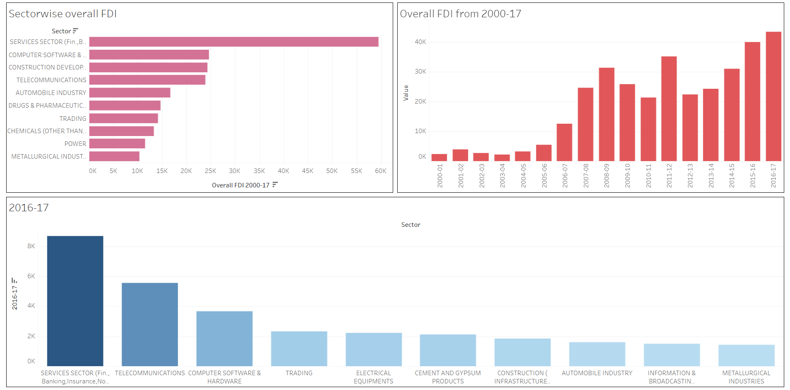
Data Analysis

Slide 10
Observations
Investment was the highest for the year 2016-17, followed by the year 2015-16.
Overall investment in SERVICES SECTOR is the highest, followed by the COMPUTER SOFTWARE & HARDWARE sector.
For 2003-04, 2004-05, and 2005-06, the investment was highest for COMPUTER SOFTWARE & HARDWARE sector. However, the investment in SERVICES SECTOR remained the highest from 2006 to 2009, and then again from 2010 to 2013. The investment continued to be the highest for the SERVICES SECTOR from 2014 to 2017.

Slide 11
Inference
Gradual increase in investment has been observed in India from the year 2000 to 2017. This implies that foreign companies are convinced with the political, economic, and social stability of India.
In terms of investment, the COMPUTER SOFTWARE & HARDWARE sector remained dominant from 2003 to 2006.
After 2006, in terms of investment, the SERVICES SECTOR remained the dominant. Even though, the investment is not the highest for SERVICES SECTOR in 2009-10, and 2013-14, the sector still remained the second dominant.

Slide 12
Inference
Moreover, from 2000 to 2006, gradual increase in foreign investment in the SERVICES SECTOR was observed.
The two most dominant sectors in terms of investment are the SERVICES SECTOR, and the COMPUTER SOFTWARE & HARDWARE sector. Therefore, it is beneficial to promote these two sectors by increasing job opportunities in these sectors for both experienced as well as freshers.

Slide 13
Thank You

